Slide 1
Capstone Project-1
Global Terrorism Analysis
By-Prasad Khedkar
(Individual Project)

Slide 2
Points of Discussion :
The Problem Statement
Summary of the Experience Set
Interested Features
Trend of Attacks with Year
Type of Attack
Affected Countries
Top Terrorist Organizations
8. Types of Weapons Used
9. Regions Affected
10. Kind of People Targeted
11. Affected Cities
12. Co-relation among Features
13. Final Conclusion

Slide 3
The Problem Statement
We are provided with the Global Terrorism Database (GTD), an
open-source database including information on terrorist attacks around the world from 1970 through 2017. The GTD includes systematic data on domestic as well as international terrorist incidents that have occurred during this time period and now includes more than 180,000 attacks. The task is to explore and analyze the data to discover key findings pertaining to terrorist activities.

Slide 4
Summary of the Experience Set :
Here, the dataset has 1,81,691 rows, from the Year-1970 to 2017, out of which 14146 entries (rows) are duplicates means 1,67,545 are the actual terrorist activities happened worldwide.
It has 135 columns, means each experience is registered along 135 features or dimensions.
We are interested in 13 features among them and perform EDA on those features.

Slide 5
Interested Features :
The 13 features we’re interested in are:
1. Year 11. Wounded
2. Month 12. Group Name
3. Day 13.Weapon Type
4. City
5. Province
6. Country
7. Region
8. Attack Type
9. Target Type
10. Killed
We will analyze these features

Slide 6
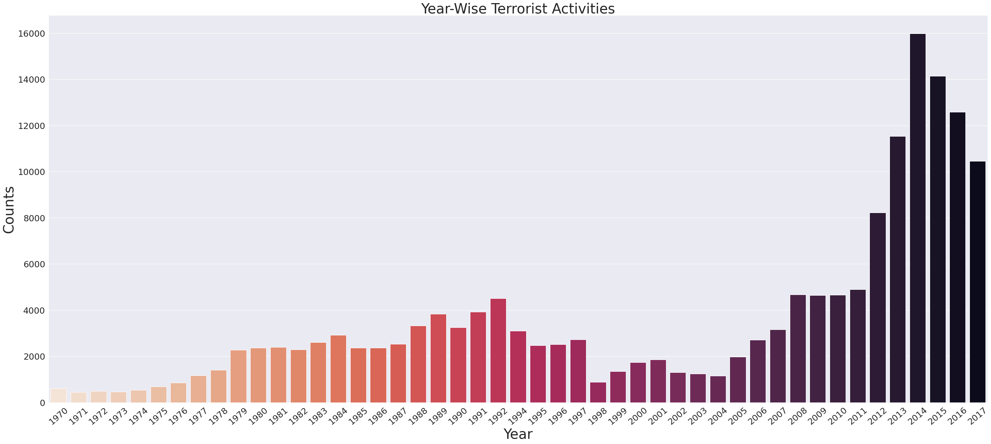
Trend of Attacks with Year :
As we can see, Year-2014 saw the highest no. of terrorist activities (around 16000 incidents)

Slide 7
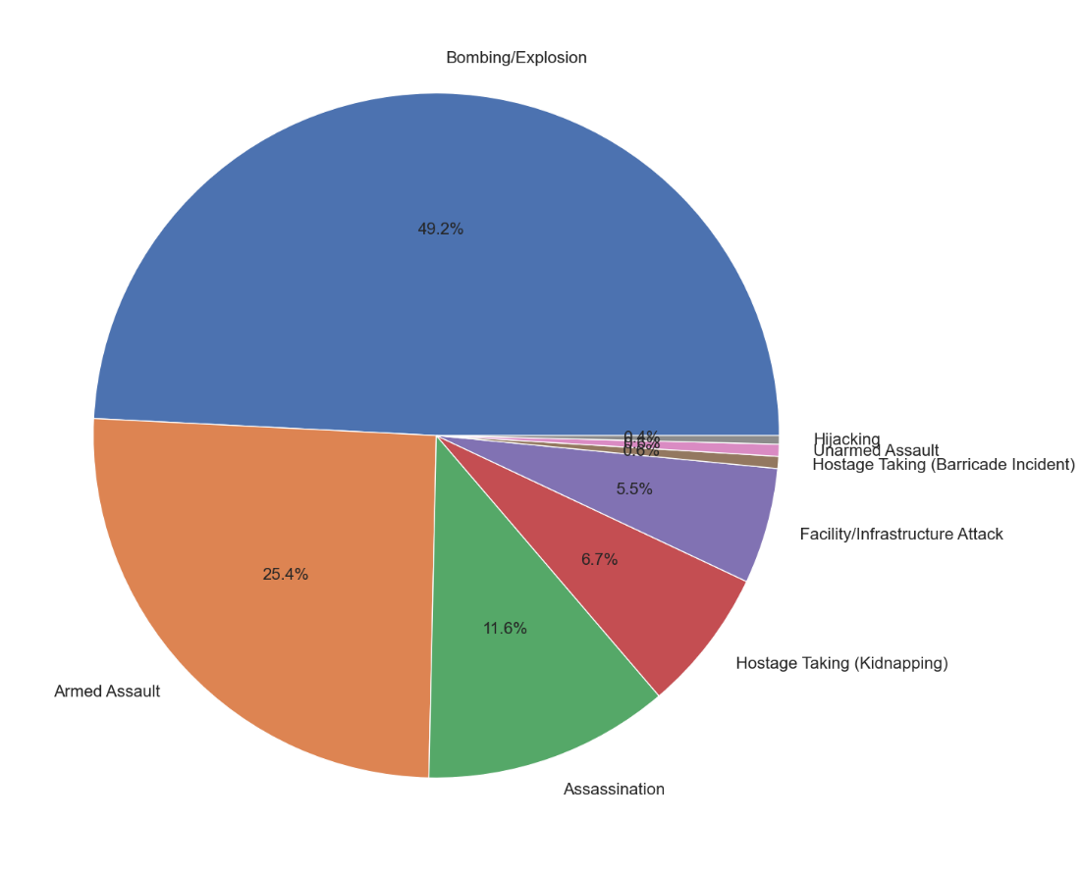
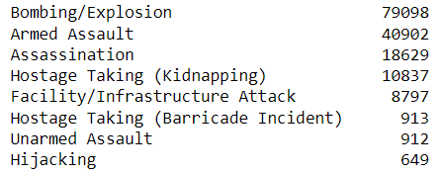
Type of Attack :
Around 49.2% of Total attacks are executed through Bombing/Explosions, followed by Armed Assault and Assassination

Slide 8
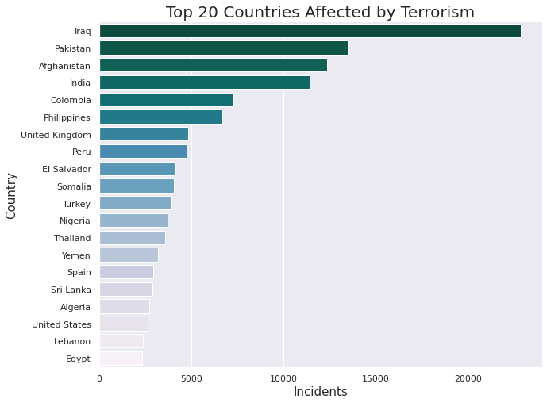
Affected Countries :
Most terrorist activities happened in Iraq, more than 25,000 incidents.
India stands 4th ,around 12,000 incidents

Slide 9
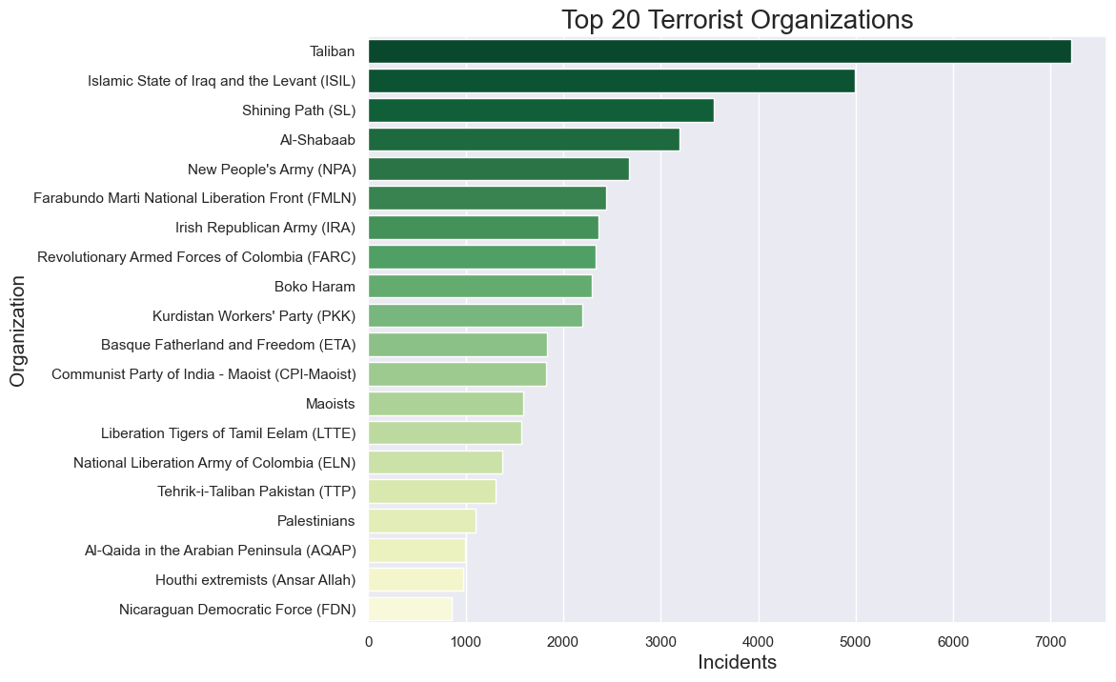
Top Terrorist Organizations :
Taliban is responsible for more than 7000 terrorist activities, followed by ISIL and
Shining Path.

Slide 10
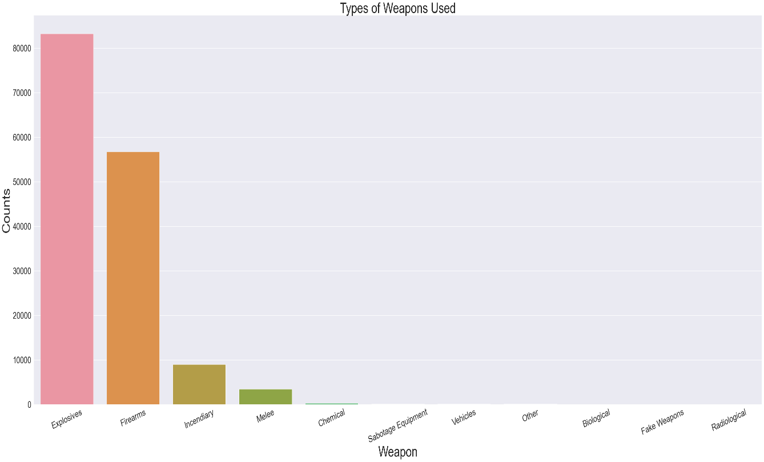
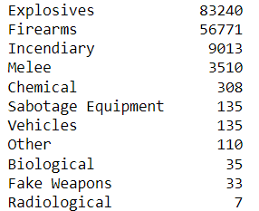
Types of Weapons Used :
Explosives are used as primary weapon (more than 80000 times), followed by Firearms(Guns)

Slide 11
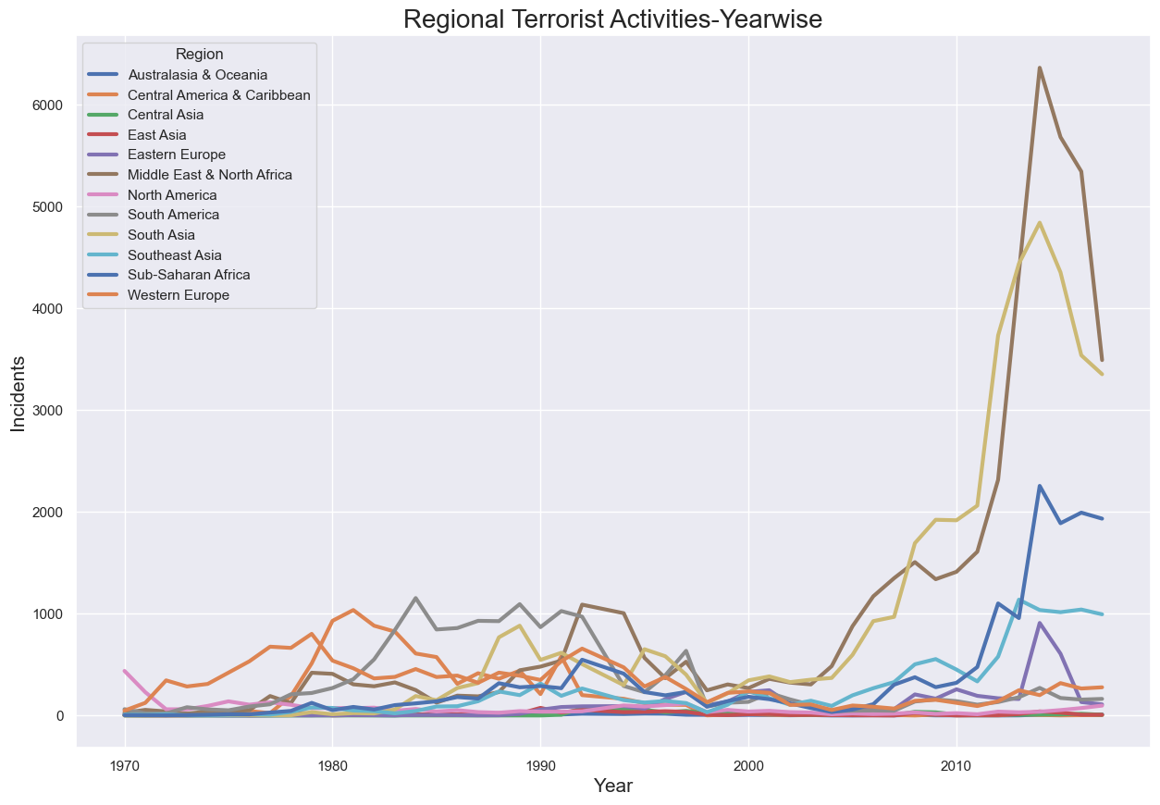
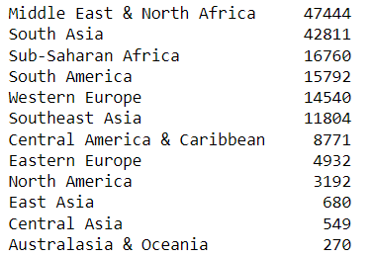
Regions Affected :
As we can see,
Middle East and North Africa(Dark Brown line) is the most affected region, followed by South Asia

Slide 12
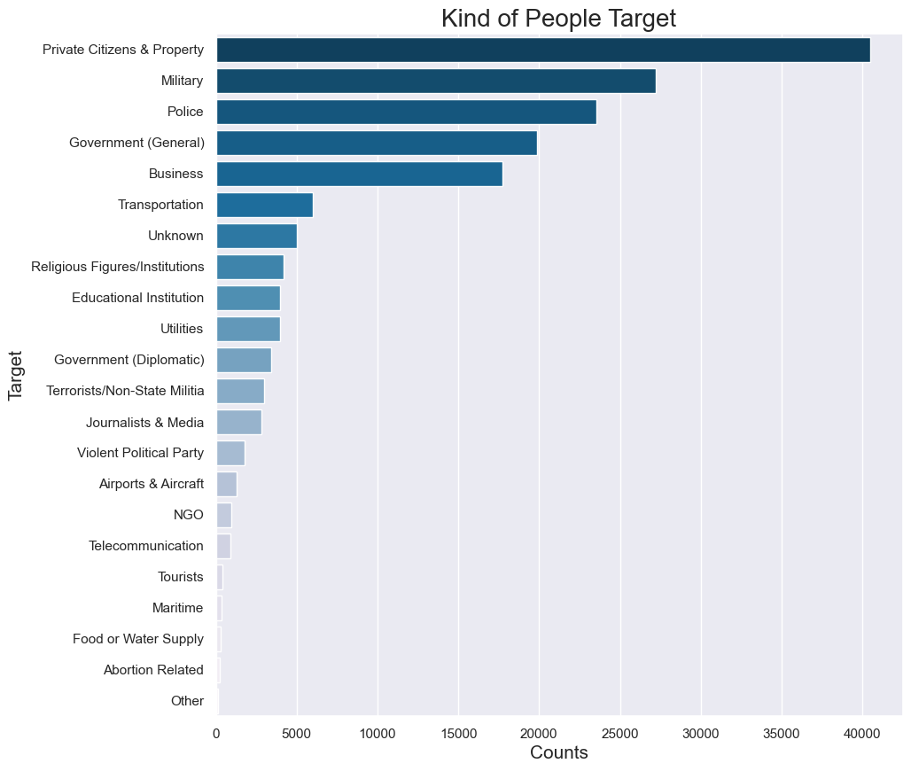
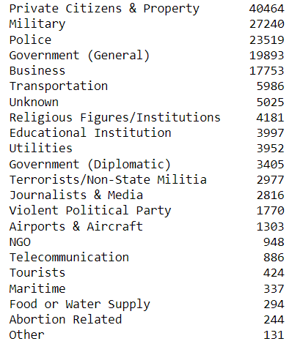
Kind of People Targeted :
Private Citizens and Property are the primary targets(more than 40,000 counts), followed by Military and Police

Slide 13
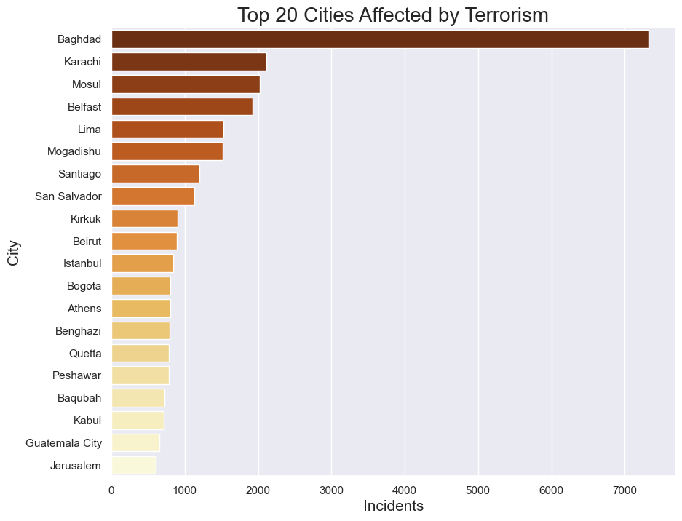
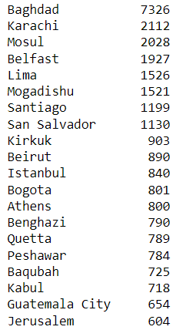
Affected Cities :
Baghdad, the capital of Iraq, is the most affected city(7000+ incidents), followed by Karachi (a city in Pakistan) and Mosul.

Slide 14
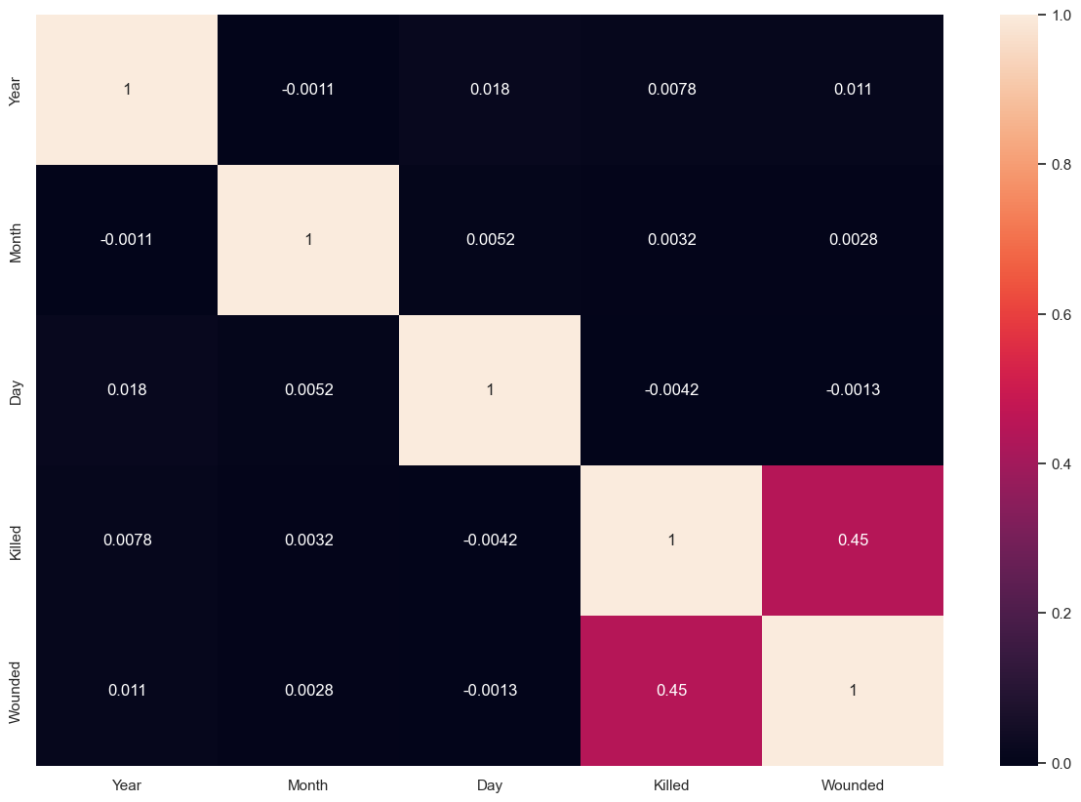
Co-relation among Features
From the heatmap we can see there is no high positive or negative co-relation between the features and no conclusions can be made.
Only ‘Killed’ and ‘Wounded’ are co-related, because people who got wounded initially may succumbed to death afterwards.

Slide 15
Final Conclusion :
With the help of different plots and charts we drew following insights from the data :
Around 4.2 lakh People died and more than 5.5 lakh got wounded during 1970-2017 due to Terrorism
Most terrorist activities happened during 2013-17, especially in the year 2014 (Total no. of attacks 15977)
Iraq is the most affected Country (Total no. of attacks 22866)
Baghdad is the most affected city (Total no. of attacks 7326)
Middle east and North Africa is the most affected region by Terrorism.These regions are known for their resources for e.g., North Africa for Diamonds and Middle East for Petroleum Resources.
Private-Citizens and Property(40464 targeted) and Millitary(27240 targeted) are the kind of people mostly targeted during attacks.
Bombing is the most frequently used method of an attack(79098 times)
Taliban and ISIL are the top Terrorist Organisations(Responsible for total 7216 and 4997 no. of attacks respectively.)
This clearly indicates that all the terrorist gangs are unitedly working towards capturing the world's best geographical locations to rule the world.

